Slide 1
Data Mining:
Concepts and Techniques
(3rd ed.)
— Chapter 4 —
Jiawei Han, Micheline Kamber, and Jian Pei
University of Illinois at Urbana-Champaign &
Simon Fraser University
©2011 Han, Kamber & Pei. All rights reserved.

Slide 2
What is a Data Warehouse?
Defined in many different ways, but not rigorously.
  A decision support database that is maintained separately from the organization’s operational database
  Support information processing by providing a solid platform of consolidated, historical data for analysis.
“A data warehouse is a subject-oriented, integrated, time-variant, and nonvolatile collection of data in support of management’s decision-making process.”—W. H. Inmon
Data warehousing:
  The process of constructing and using data warehouses

Slide 3
Data Warehouse—Subject-Oriented
Organized around major subjects, such as customer, product, sales
Focusing on the modeling and analysis of data for decision makers, not on daily operations or transaction processing
Provide a simple and concise view around particular subject issues by excluding data that are not useful in the decision support process

Slide 4
Data Warehouse—Integrated
Constructed by integrating multiple, heterogeneous data sources
  relational databases, flat files, on-line transaction records
Data cleaning and data integration techniques are applied.
  Ensure consistency in naming conventions, encoding structures, attribute measures, etc. among different data sources
    E.g., Hotel price: currency, tax, breakfast covered, etc.
  When data is moved to the warehouse, it is converted.

Slide 5
Data Warehouse—Time Variant
The time horizon for the data warehouse is significantly longer than that of operational systems
  Operational database: current value data
  Data warehouse data: provide information from a historical perspective (e.g., past 5-10 years)
Every key structure in the data warehouse
  Contains an element of time, explicitly or implicitly
  But the key of operational data may or may not contain “time element”

Slide 6
Data Warehouse—Nonvolatile
A physically separate store of data transformed from the operational environment
Operational update of data does not occur in the data warehouse environment
  Does not require transaction processing, recovery, and concurrency control mechanisms
  Requires only two operations in data accessing:
    initial loading of data and access of data

Slide 7
Why a Data Warehouse is Separated from Operational Databases
Operational databases support concurrent processing of multiple transactions. Concurrency control and recovery mechanisms are required for operational databases to ensure robustness and consistency of the database.
An operational database query allows to read and modify operations, while an OLAP query needs only read only access of stored data.
An operational database maintains current data. On the other hand, a data warehouse maintains historical data.
Data Mining: Concepts and Techniques

Slide 8

OLTP vs. OLAP

Slide 9
Data Warehouse: A Multi-Tiered Architecture
Monitor
&
Integrator
OLAP Server
Other
sources
Metadata
Analysis
Query
Reports
Data mining
Operational
DBs
Extract
Transform
Load
Refresh
Data
Warehouse
Serve
Data Marts
Data Sources
Data Storage
OLAP Engine
Front-End Tools
Notes:
Metadata is a road-map to data warehouse.
Metadata in data warehouse defines the warehouse objects.
Metadata acts as a directory. This directory helps the decision support system to locate the contents of a data warehouse.

Slide 10
Data Warehousing
Data warehousing is the process of constructing and using a data warehouse. A data warehouse is constructed by integrating data from multiple heterogeneous sources that support analytical reporting, structured and/or ad hoc queries, and decision making. Data warehousing involves data cleaning, data integration, and data consolidations.
To integrate heterogeneous databases, we have two approaches −
Query-driven Approach
Update-driven Approach
Data Mining: Concepts and Techniques
Notes:
The query-driven approach for the integration of heterogeneous databases is a method of integrating data from different sources by using a central query processor to handle all data requests. With a query-driven strategy, several sophisticated queries will be created for each separate database. There will therefore be a requirement for filtering and integration of the queries as a query-driven technique will provide complex results.

Slide 11
Extraction, Transformation, and Loading (ETL)
Data extraction
  get data from multiple, heterogeneous, and external sources
Data cleaning
  detect errors in the data and rectify them when possible
Data transformation
  convert data from legacy or host format to warehouse format
Load
  sort, summarize, consolidate, compute views, check integrity, and build indicies and partitions
Refresh
  propagate the updates from the data sources to the warehouse
Notes:
The following are the functions of data warehouse tools and utilities −

Slide 12
Three Data Warehouse Models
Enterprise warehouse
  collects all of the information about subjects spanning the entire organization
Data Mart
  a subset of corporate-wide data that is of value to a specific groups of users. Its scope is confined to specific, selected groups, such as marketing data mart
Virtual warehouse
  A set of views over operational databases
  Only some of the possible summary views may be materialized

Slide 13
Enterprise warehouse
An Enterprise warehouse collects all of the records about subjects spanning the entire organization. It supports corporate-wide data integration, usually from one or more operational systems or external data providers, and it's cross-functional in scope. It generally contains detailed information as well as summarized information and can range in estimate from a few gigabyte to hundreds of gigabytes, terabytes, or beyond.
Data Mining: Concepts and Techniques

Slide 14
Data Mart
A Data Mart is focused on a single functional area of an organization and contains a subset of data stored in a Data Warehouse. E.g., Marketing, Sales, HR or finance.
Data Mart usually draws data from only a few sources compared to a Data warehouse. Data marts are small in size and are more flexible compared to Data warehouse.
Data Mart helps to enhance user's response time due to reduction in volume of data
It provides easy access to frequently requested data.
Data Mining: Concepts and Techniques

Slide 15
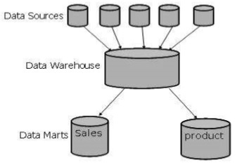
Independent (is created without the use of a central data warehouse) vs. dependent (directly from warehouse) data mart
Data Mining: Concepts and Techniques

Slide 16
Virtual Warehouses
Virtual Data Warehouses is a set of perception over the operational database. For effective query processing, only some of the possible summary vision may be materialized. A virtual warehouse is simple to build but required excess capacity on operational database servers.
Data Mining: Concepts and Techniques

Slide 17
From Tables and Spreadsheets to
Data Cubes
A data warehouse is based on a multidimensional data model which views data in the form of a data cube
A data cube, such as sales, allows data to be modeled and viewed in multiple dimensions
  Dimension tables, such as item (item_name, brand, type), or time(day, week, month, quarter, year)
  Fact table contains measures (such as dollars_sold) and keys to each of the related dimension tables
In data warehousing literature, an n-D base cube is called a base cuboid. The top most 0-D cuboid, which holds the highest-level of summarization, is called the apex cuboid. The lattice of cuboids forms a data cube.

Slide 18
Cube: A Lattice of Cuboids
all
0-D (apex) cuboid
time
item
location
supplier
1-D cuboids
time,location
item,location
location,supplier
time,item
2-D cuboids
time,supplier
item,supplier
time,location,supplier
3-D cuboids
time,item,location
time,item,supplier
item,location,supplier
4-D (base) cuboid
time, item, location, supplier

Slide 19
Conceptual Modeling of Data Warehouses
Modeling data warehouses: dimensions & measures
  Star schema: A fact table in the middle connected to a set of dimension tables
  Snowflake schema: A refinement of star schema where some dimensional hierarchy is normalized into a set of smaller dimension tables, forming a shape similar to snowflake
  Fact constellations: Multiple fact tables share dimension tables, viewed as a collection of stars, therefore called galaxy schema or fact constellation

Slide 20
Example of Star Schema
time
time_key
day
day_of_the_week
month
quarter
year
item
item_key
item_name
brand
type
supplier_type
Sales Fact Table
time_key
item_key
branch_key
branch
location
location_key
branch_key
branch_name
branch_type
location_key
street
city
state_or_province
country
units_sold
dollars_sold
avg_sales
Measures

Slide 21
Example of Snowflake Schema
time
item
time_key
day
day_of_the_week
month
quarter
year
item_key
item_name
brand
type
supplier_key
supplier
Sales Fact Table
supplier_key
supplier_type
time_key
item_key
branch_key
branch
location
location_key
location_key
street
city_key
branch_key
branch_name
branch_type
units_sold
dollars_sold
city
city_key
city
state_or_province
country
avg_sales
Measures

Slide 22
Example of Fact Constellation
time
time_key
day
day_of_the_week
month
quarter
year
item
Shipping Fact Table
item_key
item_name
brand
type
supplier_type
Sales Fact Table
time_key
time_key
item_key
shipper_key
item_key
branch_key
from_location
branch
location_key
location
to_location
branch_key
branch_name
branch_type
units_sold
location_key
street
city
province_or_state
country
dollars_cost
dollars_sold
units_shipped
avg_sales
shipper
Measures
shipper_key
shipper_name
location_key
shipper_type

Slide 23
A Concept Hierarchy:
Dimension (location)
all
all
region
Europe
...
North_America
country
Germany
...
Spain
Canada
...
Mexico
city
Frankfurt
...
Vancouver
...
Toronto
office
L. Chan
...
M. Wind

Slide 24
Multidimensional Data
Sales volume as a function of product, month, and region
Dimensions: Product, Location, Time
Hierarchical summarization paths
Region
Industry Region Year
Category Country Quarter
Product City Month Week
Office Day
Product
Month

Slide 25

A Sample Data Cube
Date
Total annual sales
of TVs in U.S.A.
1Qtr
2Qtr
3Qtr
4Qtr
sum
Product
TV
PC
U.S.A
VCR
sum
Canada
Country
Mexico
sum
All, All, All

Slide 26
Cuboids Corresponding to the Cube
all
0-D (apex) cuboid
product
date
country
1-D cuboids
product,date
product,country
date, country
2-D cuboids
3-D (base) cuboid
product, date, country

Slide 27
Typical OLAP Operations
Roll up (drill-up): summarize data
  by climbing up hierarchy or by dimension reduction
Drill down (roll down): reverse of roll-up
  from higher level summary to lower level summary or detailed data, or introducing new dimensions
Slice and dice: project and select
Pivot (rotate):
  reorient the cube, visualization, 3D to series of 2D planes

Slide 28

Fig. 3.10 Typical OLAP Operations

Slide 29
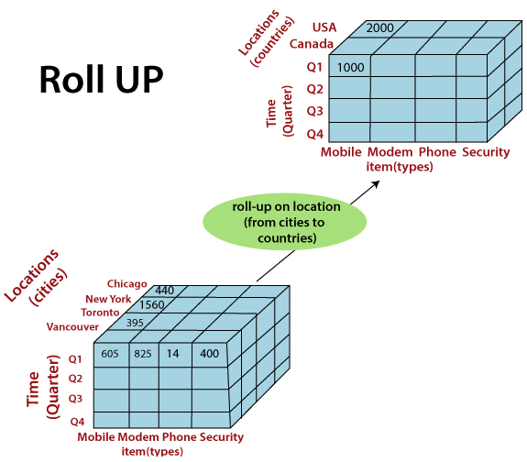

Slide 30
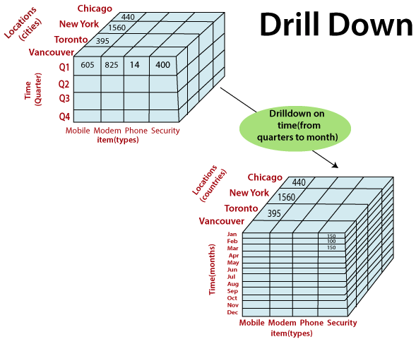

Slide 31
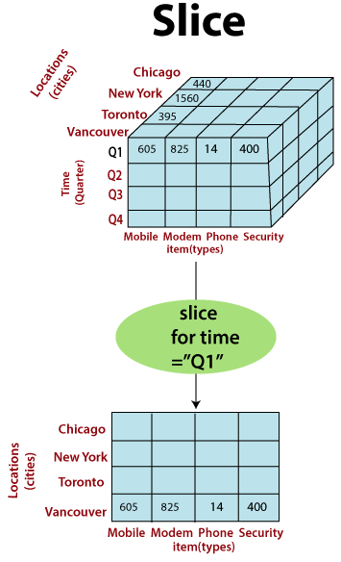

Slide 32
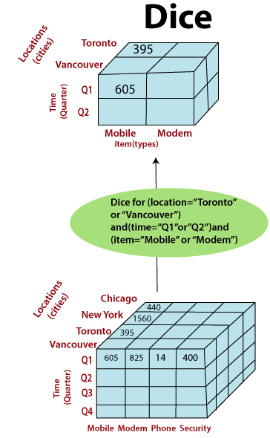

Slide 33
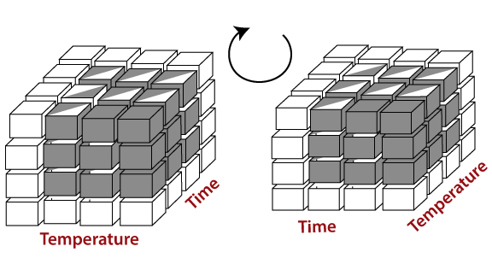
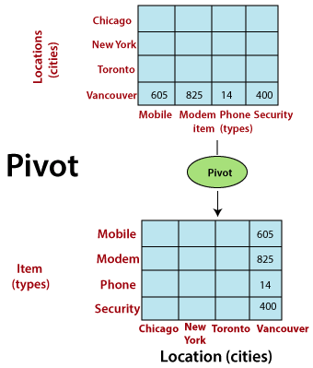

Slide 34
Data Warehouse Usage
Three kinds of data warehouse applications
  Information processing
    supports querying, basic statistical analysis, and reporting using crosstabs, tables, charts and graphs
  Analytical processing
    multidimensional analysis of data warehouse data
    supports basic OLAP operations, slice-dice, drilling, pivoting
  Data mining
    knowledge discovery from hidden patterns
    supports associations, constructing analytical models, performing classification and prediction, and presenting the mining results using visualization tools

Slide 35
References
https://www.tutorialspoint.com/dwh/dwh_architecture.htm
https://www.javatpoint.com/data-warehouse-what-is-dimensional-modeling
Data Mining: Concepts and Techniques

